Slide 1
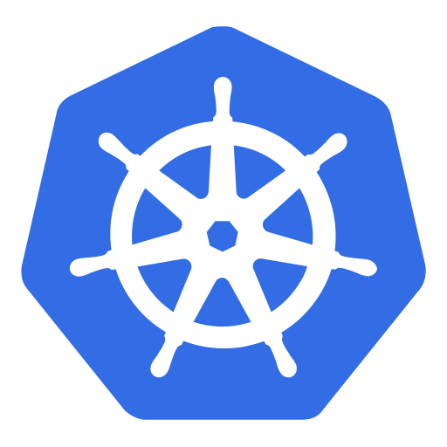
Kubernetes

Slide 2
Previous Lecture summary:
Containerization is a type of virtualization at the application level, which allows for multiple isolated user space instances on a single kernel. These instances are called containers.
Containers provide a standard method of packaging an application's code, runtime, system tools, system libraries, and configurations into one instance. Containers share one kernel (operating system), which is installed on the hardware.
Docker is a software platform that allows you to build, test, and deploy applications quickly, packaging software into standardized units called containers.

Slide 3
Contents
Container Orchestration
Orchestration Tools
Kubernetes
Kubernetes Architecture
Kubernetes Features
Docker Vs Kubernetes

Slide 4
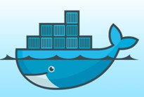

Container Orchestration
Container orchestration automates the provisioning, scaling, deployment, availability, and lifecycle management of containers.
Container orchestration is a tool that use to automate the Containers management.

Slide 5
Provisioning
Provisioning is the process of setting up IT infrastructure. It can also refer to the steps required to manage access to data and resources, and make them available to users and systems.
When the term “provisioning” is used, it can mean many different types of provisioning, such as server provisioning, network provisioning, user provisioning, service provisioning, and more.

Slide 6
Scaling
In cloud computing, scaling is the process of adding or removing compute, storage, and network services to meet the demands a workload makes for resources in order to maintain availability and performance as utilization increases.
Scale Up (Vertical Scaling)
Scaling up is the process of resizing a server (or replacing it with another server) to give it supplemental or fewer CPUs, memory, or network capacity.
Scale Out (Horizontal Scaling)
Instead of resizing an application to a bigger server, scaling out splits the workload across multiple servers that work in parallel.
Auto-scaling is the process of automatically increasing or decreasing the computational resources delivered to a cloud workload based on need.

Slide 7
Deployment
Software deployment is all of the processes that make a software system available for use.
Cloud deployment is the process of deploying an application through one or more hosting models—software as a service (SaaS), platform as a service (PaaS) and/or infrastructure as a service (IaaS).

Slide 8
Container Orchestration Tools
Some popular open source container orchestration tools include
Kubernetes
Docker Swarm

Slide 9
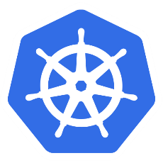
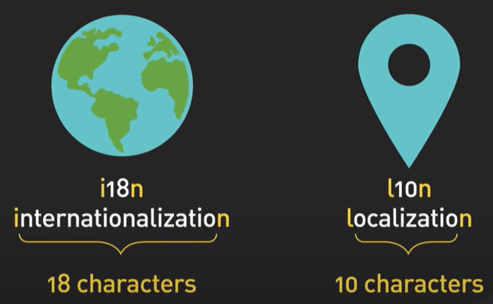
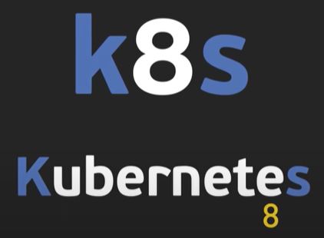
Kubernetes
Kubernetes is an open-source container orchestration tool for automating deployment, scaling, Load-balancing, scheduling the run isolated containers and management of containerized applications.
This platform is designed and developed by Google in 2014 built in GO programming language.
Supports JSON or YAML (Ain't Markup Language) YAML is a human-readable data-serialization language.
Kubernetes is also known as 'k8s‘. (some pronounce it as keits)
The open-source project is hosted by the Cloud Native Computing Foundation (CNCF).

Slide 10
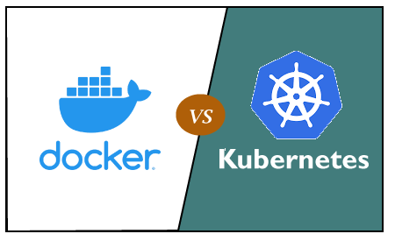
Docker vs. Kubernetes
Difference

Slide 11
Docker vs. Kubernetes (Cont.)
Docker | Kubernetes
Docker is developed by Docker Inc. | Kubernetes is developed by Google.
It was first released in 2013. | It was first released in 2014.
Docker create containers / Images | Kubernetes Create Clusters
Container based technology used to create isolated environment for applications. | It is an infrastructure for managing multiple containers.
Its public cloud service provider is only Azure. | Its public cloud service providers are Google, Azure, and AWS.
It is less customizable. | It is highly customizable.
It is easy to install. | It is complex to install.
It cannot do auto-scaling. | It can do auto-scaling.
It does not provide any dashboard. | It provides a Web UI dashboard.
Its container limit is 95000. (95 Thousands) | Its container limit is 300000. (300 Thousands)

Slide 12
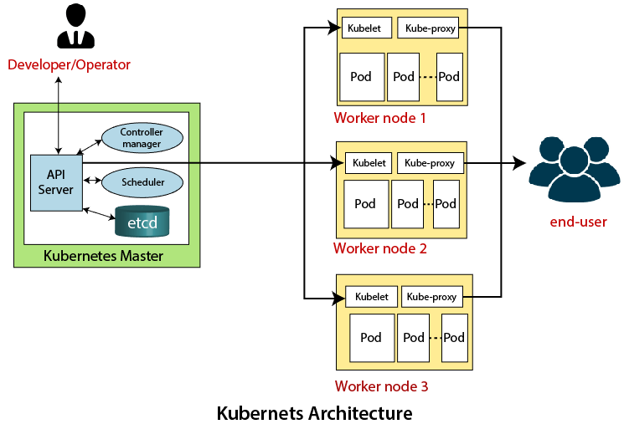
Kubernetes Architecture

Slide 13
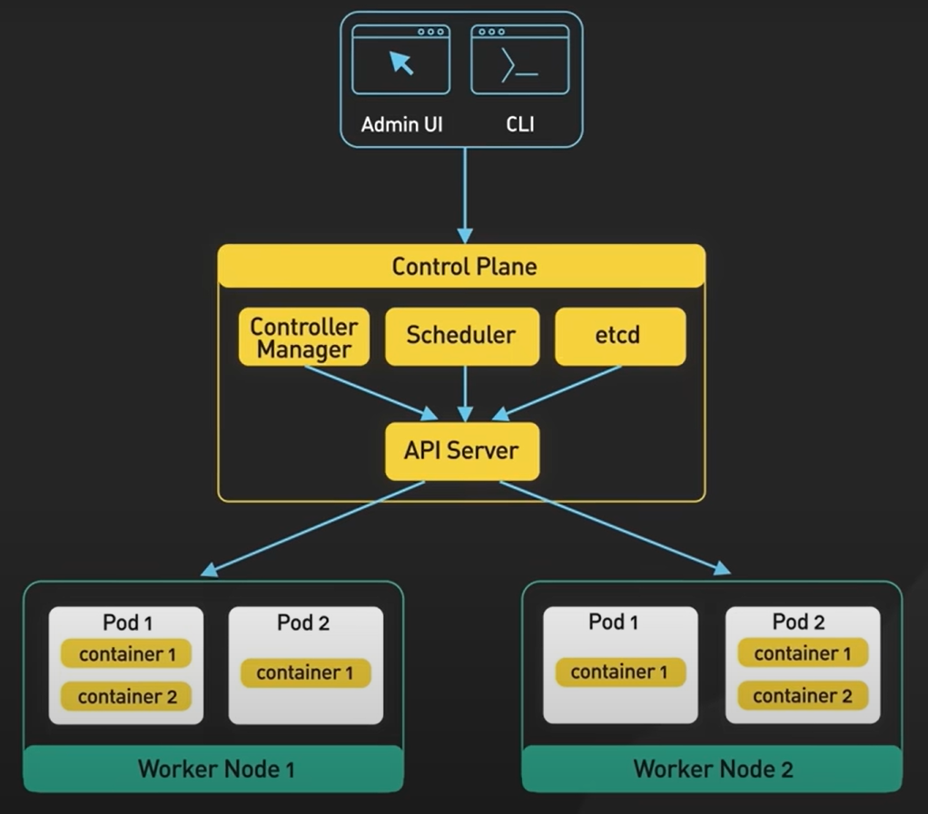

Slide 14
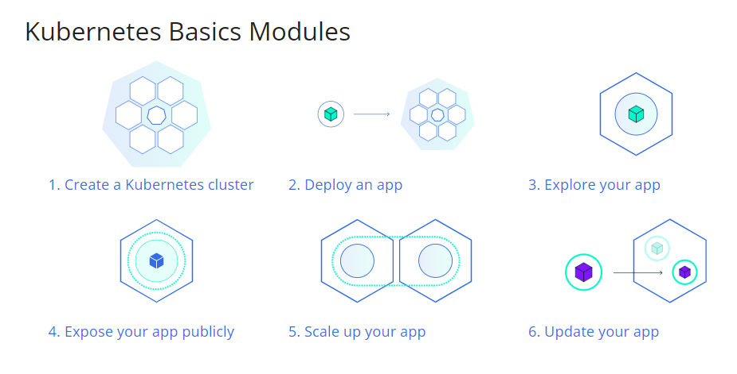
https://kubernetes.io/docs/tutorials/kubernetes-basics/
Notes:
https://kubernetes.io/docs/tutorials/kubernetes-basics/

Slide 15
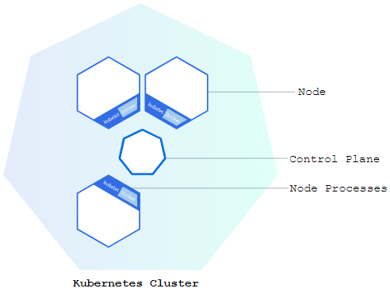
Using Minikube to Create a Cluster
Kubernetes coordinates a highly available cluster of computers that are connected to work as a single unit
The abstractions in Kubernetes allow you to deploy containerized applications to a cluster without tying them specifically to individual machines
Kubernetes automates the distribution and scheduling of application containers across a cluster in a more efficient way
A Kubernetes cluster consists of two types of resources:
The Control Plane coordinates the cluster
Nodes are the workers that run applications

Slide 16
Control Plane
The Control Plane is responsible for managing the cluster
Control Plane coordinates all activities in your cluster, such as
scheduling applications
maintaining applications' desired state
scaling applications
and rolling out new updates

Slide 17
Node
A node is a VM or a physical computer that serves as a worker machine in a Kubernetes cluster
Each node has a Kubelet which is an agent for managing the node and communicating with the Kubernetes control plane
The node should also have tools for handling container operations, such as containerd or CRI-O
A Kubernetes cluster that handles production traffic should have a minimum of three nodes
Because if one node goes down, both an etcd member and a control plane instance are lost

Slide 18
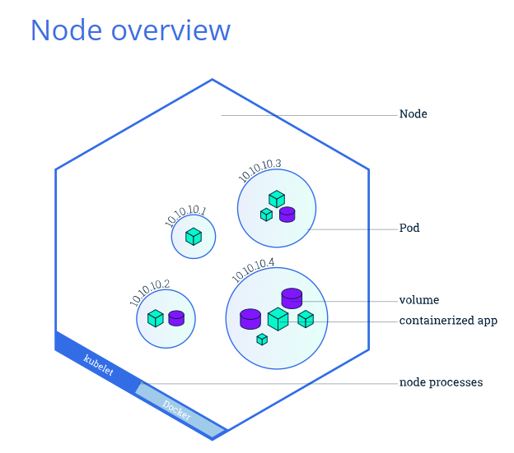

Slide 19
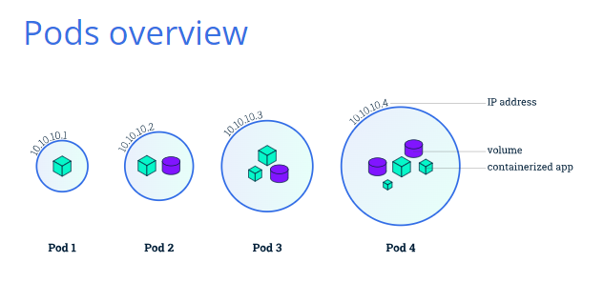

Slide 20
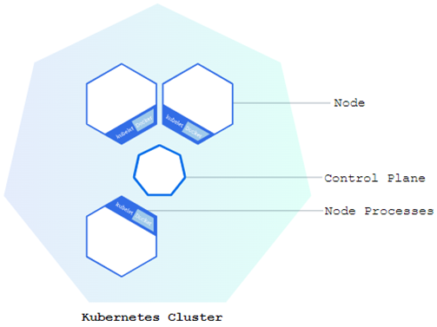
Kubelet and Control Plane Communication
When you deploy applications on Kubernetes, you tell the control plane to start the application containers
The control plane schedules the containers to run on the cluster's nodes
Node-level components, such as the kubelet, communicate with the control plane using the Kubernetes API
A Kubernetes cluster can be deployed on either physical or virtual machines

Slide 21

Minikube
To get started with Kubernetes development, you can use Minikube
Minikube is a lightweight Kubernetes implementation that creates a VM on your local machine and deploys a simple cluster containing only one node
Minikube is available for Linux, macOS, and Windows systems
The Minikube CLI provides basic bootstrapping operations for working with your cluster, including start, stop, status, and delete

Slide 22
minikube start
minikube is local Kubernetes, focusing on making it easy to learn and develop for Kubernetes
All you need is Docker (or similarly compatible) container or a Virtual Machine environment, and Kubernetes is a single command away: minikube start
What you’ll need
2 CPUs or more
2GB of free memory
20GB of free disk space
Internet connection
Container or virtual machine manager, such as: Docker, QEMU, Hyperkit, Hyper-V, KVM, Parallels, Podman, VirtualBox, or VMware Fusion/Workstation

Slide 23
Using kubectl to Create a Deployment
You can create and manage a Deployment by using the Kubernetes command line interface, kubectl
Kubectl uses the Kubernetes API to interact with the cluster
When you create a Deployment, you'll need to specify the container image for your application and the number of replicas that you want to run
You can change that information later by updating your Deployment

Slide 24
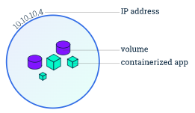
Kubernetes Pods (1/3)
When you created a Deployment, Kubernetes created a Pod to host your application instance
A Pod is a Kubernetes abstraction that represents a group of one or more application containers (such as Docker)
And some shared resources, such as:
Shared storage, as Volumes
Networking, as a unique cluster IP address
Information about how to run each container, such as the container image version or specific ports to use
A Pod models an application-specific "logical host" and can contain different application containers which are relatively tightly coupled
For example, a Pod might include both the container with your Node.js app as well as a different container that feeds the data to be published by the Node.js webserver
The containers in a Pod share an IP Address and port space, are always co-located and co-scheduled, and run in a shared context on the same Node.

Slide 25
Kubernetes Pods (2/3)
Pods are the atomic unit on the Kubernetes platform
When we create a Deployment on Kubernetes, that Deployment creates Pods with containers inside them
Each Pod is tied to the Node where it is scheduled, and remains there until termination (according to restart policy) or deletion
In case of a Node failure, identical Pods are scheduled on other available Nodes in the cluster.

Slide 26
Kubernetes Pods (3/3)
A Pod always runs on a Node. A Node is a worker machine in Kubernetes and may be either a virtual or a physical machine
Kubernetes control plane automatically handles scheduling the pods across the Nodes in the cluster
The control plane's automatic scheduling takes into account the available resources on each Node
Every Kubernetes Node runs at least:
Kubelet, a process responsible for communication between the Kubernetes control plane and the Node; it manages the Pods and the containers running on a machine.
A container runtime (like Docker) responsible for pulling the container image from a registry, unpacking the container, and running the application.

Slide 29
Explore More
About Pods
https://kubernetes.io/docs/concepts/workloads/pods/
About Nodes
https://kubernetes.io/docs/concepts/architecture/nodes/

Slide 30
A Kubernetes Service is an abstraction layer which defines a logical set of Pods and enables external traffic exposure, load balancing and service discovery for those Pods.

Slide 31
Kubernetes Services
Kubernetes Pods are mortal. Pods have a lifecycle. When a worker node dies, the Pods running on the Node are also lost
A ReplicaSet might then dynamically drive the cluster back to the desired state via the creation of new Pods to keep your application running
A Service in Kubernetes is an abstraction which defines a logical set of Pods and a policy by which to access them
Services enable a loose coupling between dependent Pods.
A Service is defined using YAML or JSON, like all Kubernetes object manifests.
The set of Pods targeted by a Service is usually determined by a label selector

Slide 32
Kubernetes Services
Although each Pod has a unique IP address, those IPs are not exposed outside the cluster without a Service
Services allow your applications to receive traffic
Services can be exposed in different ways by specifying a type in the spec of the Service:
ClusterIP (default) - Exposes the Service on an internal IP in the cluster. This type makes the Service only reachable from within the cluster.
NodePort - Exposes the Service on the same port of each selected Node in the cluster using NAT. Makes a Service accessible from outside the cluster using <NodeIP>:<NodePort>. Superset of ClusterIP.
LoadBalancer - Creates an external load balancer in the current cloud (if supported) and assigns a fixed, external IP to the Service. Superset of NodePort.
ExternalName - Maps the Service to the contents of the externalName field (e.g. foo.bar.example.com), by returning a CNAME record with its value. No proxying of any kind is set up. This type requires v1.7 or higher of kube-dns, or CoreDNS version 0.0.8 or higher.

Slide 33
Kubernetes Services
A Service routes traffic across a set of Pods
Services are the abstraction that allows pods to die and replicate in Kubernetes without impacting your application
Discovery and routing among dependent Pods (such as the frontend and backend components in an application) are handled by Kubernetes Services
Services match a set of Pods using labels and selectors, a grouping primitive that allows logical operation on objects in Kubernetes

Slide 34
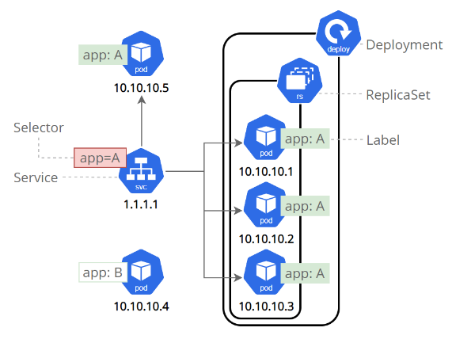
Labels can be attached to objects at creation time or later

Slide 35
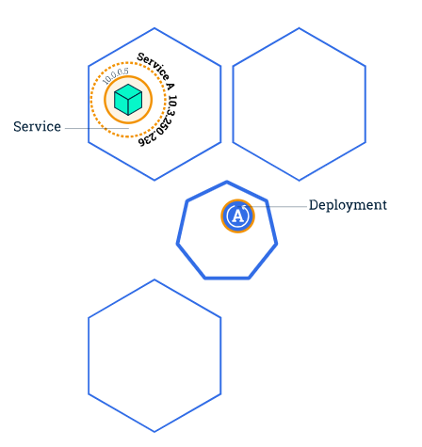
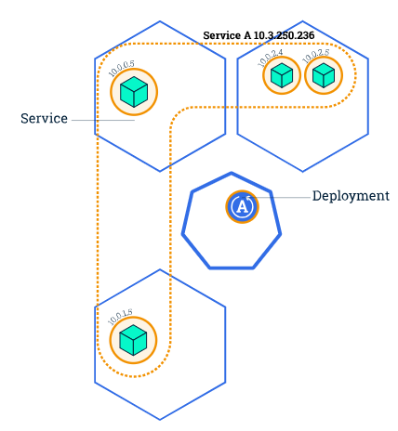
Scaling an Application
Scale

Slide 36
Scaling an Application
Scaling out a Deployment will ensure new Pods are created and scheduled to Nodes with available resources
Scaling will increase the number of Pods to the new desired state
Kubernetes also supports autoscaling of Pods
Scaling to zero is also possible, and it will terminate all Pods of the specified Deployment
Running multiple instances of an application will require a way to distribute the traffic to all of them
Services have an integrated load-balancer that will distribute network traffic to all Pods of an exposed Deployment
Services will monitor continuously the running Pods using endpoints, to ensure the traffic is sent only to available Pod

Slide 37
Updating an Application
Users expect applications to be available all the time, and developers are expected to deploy new versions of them several times a day
In Kubernetes this is done with rolling updates
A rolling update allows a Deployment update to take place with zero downtime
It does this by incrementally replacing the current Pods with new ones
The new Pods are scheduled on Nodes with available resources, and Kubernetes waits for those new Pods to start before removing the old Pods
In Kubernetes, updates are versioned and any Deployment update can be reverted to a previous (stable) version.

Slide 38
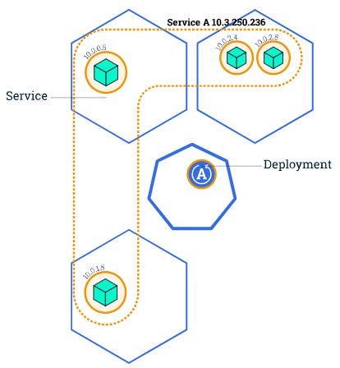
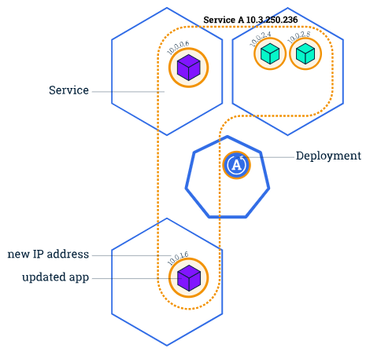
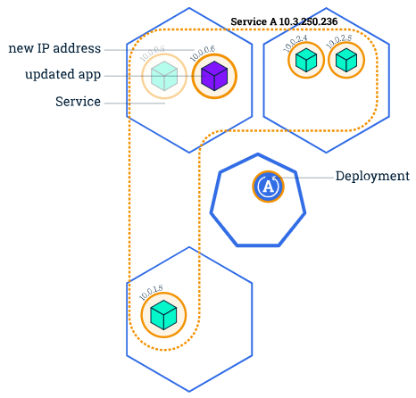
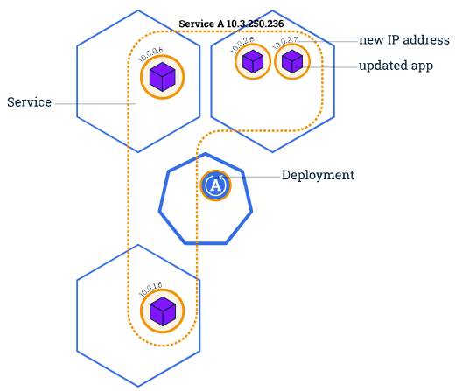
Rolling Updates Overview
1
3
2
4

Slide 39
Updating an Application
Similar to application Scaling, if a Deployment is exposed publicly, the Service will load-balance the traffic only to available Pods during the update
An available Pod is an instance that is available to the users of the application
Rolling updates allow the following actions:
Promote an application from one environment to another (via container image updates)
Rollback to previous versions
Continuous Integration and Continuous Delivery of applications with zero downtime

Slide 40
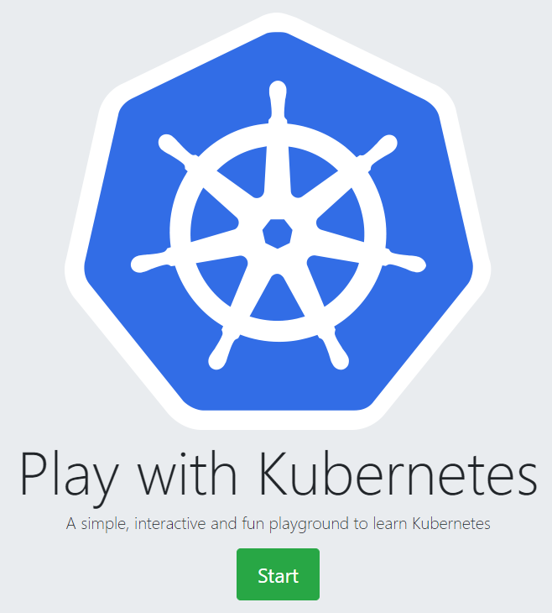
https://labs.play-with-k8s.com/

Slide 41
Feature/Tool | Kubernetes (K8s) | Minikube | kubectl | MicroK8s
Description | An open-source system for automating deployment, scaling, and management of containerized applications. | A tool that makes it easy to run Kubernetes locally. Minikube runs a single-node Kubernetes cluster inside a VM on your laptop for users looking to try out Kubernetes or develop with it day-to-day. | A command line tool for controlling Kubernetes clusters. It allows users to deploy applications, inspect and manage cluster resources, and view logs. | A snap-based Kubernetes installation designed for simplicity and ease of use. It's a lightweight, fully conformant Kubernetes for developers and edge computing.
Use Case | Ideal for production environments. Can manage complex applications with high scalability needs. | Great for development and testing. Simulates Kubernetes on a local machine. | Essential for interacting with your Kubernetes cluster. It performs every task needed to manage clusters. | Best for IoT and edge-based projects, developers looking for an easy setup and operations.
Installation Complexity | High, requires setup of multiple nodes and management components. | Low, simple setup with a single command to start a cluster. | Low, requires only the binary installed on your machine. | Low, installs with a single command and auto-updates.
Scalability | Highly scalable to thousands of nodes. | Limited to a single node. | N/A (tool for managing scalability, not scalable itself). | Scalable but optimized for simpler, smaller deployments than a full Kubernetes setup.
Platform Compatibility | Runs on any cloud, on-premise, or hybrid environment. | Primarily for local development, limited to platforms that support VMs or Docker. | Works wherever Kubernetes is installed. | Optimized for Ubuntu but available for a range of Linux distributions.
Community and Support | Large community with extensive resources and support. | Good community support, plenty of resources for new users. | Broad community support as part of the Kubernetes ecosystem. | Growing community, backed by Canonical with professional support available.

Slide 42
Key Components of Kubernetes
Pod
It is the smallest and simplest basic unit of the Kubernetes application. This object indicates the processes which are running in the cluster.
Node
A node is nothing but a single host, which is used to run the virtual or physical machines. A node in the Kubernetes cluster is also known as a minion.
Service
A service in a Kubernetes is a logical set of pods, which works together. With the help of services, users can easily manage load balancing configurations.

Slide 43
Kubernetes Architecture (Cont.)
The architecture of Kubernetes actually follows the client-server architecture.
It consists of two main components:
Master Node (Control Plane)
Slave/worker node

Slide 44
Master Node or Kubernetes Control Plane
The master node in a Kubernetes architecture is used to manage the states of a cluster.
It is actually an entry point for all types of administrative tasks.
In the Kubernetes cluster, more than one master node is present for checking the fault tolerance.

Slide 45
Master Node Components
API Server
The Kubernetes API server receives the REST commands which are sent by the user. After receiving, it validates the REST requests, process, and then executes them. After the execution of REST commands, the resulting state of a cluster is saved in 'etcd' as a distributed key-value store.
Scheduler
The scheduler in a master node schedules the tasks to the worker nodes. And, for every worker node, it is used to store the resource usage information. In other words, it is a process that is responsible for assigning pods to the available worker nodes.

Slide 46
Master Node Components (Cont.)
Controller Manager
The Controller manager is also known as a controller. It is a daemon that executes in the non-terminating control loops. The controllers in a master node perform a task and manage the state of the cluster. In the Kubernetes, the controller manager executes the various types of controllers for handling the nodes, endpoints, etc.
ETCD
It is an open-source, simple, distributed key-value storage.
It is used to store the cluster data.
It is a part of a master node which is written in a GO programming language.
(Linux directory structure: In UNIX, all system configuration files for a single system are contained in a folder called “/etc;” “d” stands for “distributed.”)

Slide 47
Worker/Slave node
The Worker node in a Kubernetes is also known as minions.
A worker node is a physical machine that executes the applications using pods.
It contains all the essential services which allow a user to assign the resources to the scheduled containers.

Slide 48
Worker/Slave components
Kubelet
This component is an agent service that executes on each worker node in a cluster.
It ensures that the pods and their containers are running smoothly.
Every kubelet in each worker node communicates with the master node.
It also starts, stops, and maintains the containers which are organized into pods directly by the master node.

Slide 49
Worker/Slave components (Cont.)
Kube-proxy
It is a proxy service of Kubernetes, which is executed simply on each worker node in the cluster.
The main aim of this component is request forwarding.
Each node interacts with the Kubernetes services through Kube-proxy.

Slide 50
Worker/Slave components (Cont.)
Pods
A pod is a combination of one or more containers which logically execute together on nodes. One worker node can easily execute multiple pods.

Slide 51
Features of Kubernetes
Pod:
It is a deployment unit in Kubernetes with a single Internet protocol address.
Horizontal Scaling:
It is an important feature in the Kubernetes. This feature uses a HorizontalPodAutoscalar to automatically increase or decrease the number of pods in a deployment, replication controller, replica set, or statful set on the basis of observed CPU utilization.
Automatic Bin Packing:
Kubernetes helps the user to declare the maximum and minimum resources of computers for their containers.
Service Discovery and load balancing:
Kubernetes assigns the IP addresses and a Name of DNS for a set of containers, and also balances the load across them.

Slide 52
Features of Kubernetes (Cont.)
Persistent Storage:
Kubernetes provides an essential feature called 'persistent storage' for storing the data, which cannot be lost after the pod is killed or rescheduled. Kubernetes supports various storage systems for storing the data, such as Google Compute Engine's Persistent Disks (GCE PD) or Amazon Elastic Block Storage (EBS). It also provides the distributed file systems: NFS or GFS.
Self-Healing:
This feature plays an important role in the concept of Kubernetes. Those containers which are failed during the execution process, Kubernetes restarts them automatically. And, those containers which do not reply to the user-defined health check, it stops them from working automatically.

Slide 53
Features of Kubernetes (Cont.)
Automated rollouts and rollbacks:
Using the rollouts, Kubernetes distributes the changes and updates to an application or its configuration. If any problem occurs in the system, then this technique rollbacks those changes for you immediately.

Slide 54
Thanks
…?

